Slide 1
Module 2: Central tendency, shape, and difference in means
MSIR 525
Monday, September 23, 2019

Slide 2
Recap of Module 1 (check list from syllabus; see pages 1-2)
We learned about the NHST framework
We developed an understanding of p-values and how they can be used to inform evidence-based management decisions
We compared different types of error that can threaten our inferences and conclusions
We also learned how one can attempt to avoid these errors and disclosures that must be given if a study is underpowered
We contrasted three different research designs (e.g. observational) and two different data collection approaches (e.g., longitudinal)
We learned about different data sources and data types
We summarized several types of validity and phenomena that may threaten them

Slide 3
Agenda for Module 2
9/23/2019
Summarizing data (frequency distributions); fitting data (central tendency and shape); interpretation and communication; issues in datasets
9/25/2019
Assess whether or not two means are *statistically* different from each other (i.e., a t-test)
9/30/2019
Assess whether or not multiple means are *statistically different from each other (i.e., ANOVA test)
10/2/2019
Module 2 recap and software tutorial (R must be installed by this date!!)
10/7/2019
In-class exercise for credit (i.e., a hackathon)
Applying what we learned in M2 to ascertain whether or not a meaningful group difference exists

Slide 4
Agenda for Module 2
9/23/2019
Summarizing data (frequency distributions); fitting data (central tendency and shape); interpretation and communication; issues in datasets
9/25/2019
Assess whether or not two means are *statistically* different from each other (i.e., a t-test)
9/30/2019
Assess whether or not multiple means are *statistically different from each other (i.e., ANOVA test)
10/2/2019
Module 2 recap and software tutorial (R must be installed by this date!!)
10/7/2019
In-class exercise for credit (i.e., a hackathon)
Applying what we learned in M2 to ascertain whether or not a meaningful group difference exists

Slide 5
Agenda for Module 2
9/23/2019
Summarizing data (frequency distributions); fitting data (central tendency and shape); interpretation and communication; issues in datasets
9/25/2019
Assess whether or not two means are *statistically* different from each other (i.e., a t-test)
9/30/2019
Assess whether or not multiple means are *statistically* different from each other (i.e., ANOVA test)
10/2/2019
Module 2 recap and software tutorial (R must be installed by this date!!)
10/7/2019
In-class exercise for credit (i.e., a hackathon)
Applying what we learned in M2 to ascertain whether or not a meaningful group difference exists

Slide 6
Agenda for Module 2
9/23/2019
Summarizing data (frequency distributions); fitting data (central tendency and shape); interpretation and communication; issues in datasets
9/25/2019
Assess whether or not two means are *statistically* different from each other (i.e., a t-test)
9/30/2019
Assess whether or not multiple means are *statistically* different from each other (i.e., ANOVA test)
10/2/2019
Module 2 recap and software tutorial (R must be installed by this date!!)
10/7/2019
In-class exercise for credit (i.e., a hackathon)
Applying what we learned in M2 to ascertain whether or not a meaningful group difference exists

Slide 7
Agenda for Module 2
9/23/2019
Summarizing data (frequency distributions); fitting data (central tendency and shape); interpretation and communication; issues in datasets
9/25/2019
Assess whether or not two means are *statistically* different from each other (i.e., a t-test)
9/30/2019
Assess whether or not multiple means are *statistically* different from each other (i.e., ANOVA test)
10/2/2019
Module 2 recap and software tutorial (R must be installed by this date!!)
10/7/2019
In-class exercise for credit (i.e., a hackathon)
Applying what we learned in M2 to ascertain whether or not a meaningful group difference exists

Slide 8
Agenda for Module 2
Let’s get started! ☺

Slide 9
Summarizing Data
Frequency distribution

Slide 10
Summarizing Data
Frequency distribution
A table or graph that shows each possible score along with the number of times that score was observed in the data.

Slide 11
Summarizing Data
Frequency distribution
A table or graph that shows each possible score along with the number of times that score was observed in the data.

Slide 12
Summarizing Data
Frequency distribution
A table or graph that shows each possible score along with the number of times that score was observed in the data.

Slide 13
Summarizing Data
Frequency distribution
A table or graph that shows each possible score along with the number of times that score was observed in the data.
CAN BE VISUALIZED IN A BARPLOT

Slide 14
Summarizing Data
Frequency distribution
A table or graph that shows each possible score along with the number of times that score was observed in the data.
CAN BE VISUALIZED IN A BARPLOT
CAN BE USED TO SUMMARIZE ALL TYPES OF DATA (SEE MODULE 1)

Slide 15
Summarizing Data
Relative frequency
Compared to the (raw) frequency itself, this is a way to make even better sense of observed data

Slide 16
Summarizing Data
Relative frequency
Compared to the (raw) frequency itself, this is a way to make even better sense of observed data
Represents how often a response is observe relative to the total number of responses
“What proportion of the respondents gave a rating of 7 for stress?”

Slide 17
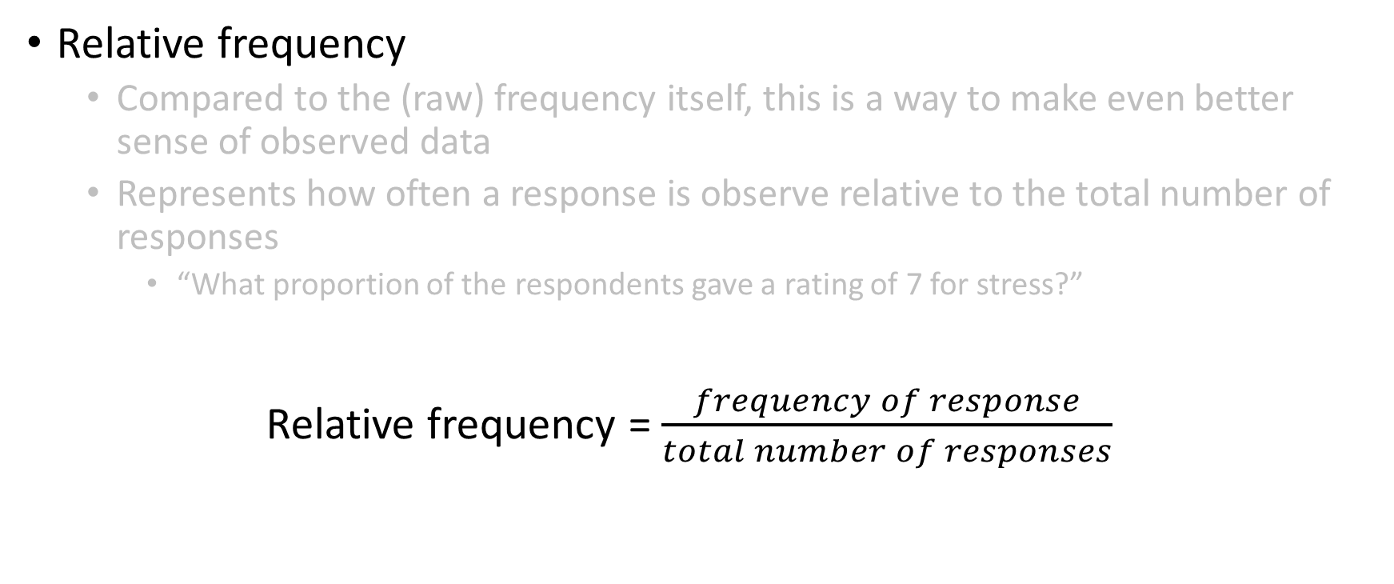
Summarizing Data
Relative frequency
Compared to the (raw) frequency itself, this is a way to make even better sense of observed data
Represents how often a response is observe relative to the total number of responses
“What proportion of the respondents gave a rating of 7 for stress?”
Relative frequency = $\frac{frequency of response}{total number of responses}$

Slide 18
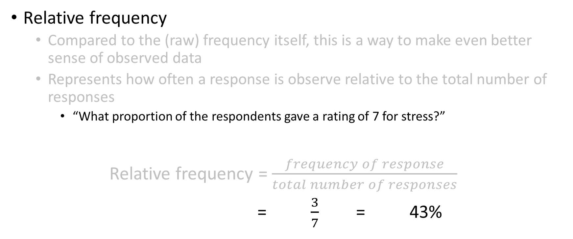
Summarizing Data
Relative frequency
Compared to the (raw) frequency itself, this is a way to make even better sense of observed data
Represents how often a response is observe relative to the total number of responses
“What proportion of the respondents gave a rating of 7 for stress?”
Relative frequency = $\frac{frequency of response}{total number of responses}$
= $\frac{3}{7}$ = 43%

Slide 19
Summarizing Data
Cumulative frequency and cumulative percentage
An assessment of the total frequency (percentage) of all categories up to and including the category of interest

Slide 20
Summarizing Data
Cumulative frequency and cumulative percentage
An assessment of the total frequency (percentage) of all categories up to and including the category of interest
Cumulative frequency_{n} = frequency_{n} + cumulative frequency_{n-1}

Slide 21
Summarizing Data
Cumulative frequency and cumulative percentage
An assessment of the total frequency (percentage) of all categories up to and including the category of interest
Cumulative percentage_{n} = percentage_{n} + cumulative percentage_{n-1}

Slide 22
Summarizing Data
Mean (or median) splits
A method used to estimate the number of “high” vs. “low” responses observed in a dataset

Slide 23
Summarizing Data
Mean (or median) splits
A method used to estimate the number of “high” vs. “low” responses observed in a dataset
Example: How many people have “high” and “low” levels of job satisfaction?

Slide 24
Summarizing Data
Mean (or median) splits
A method used to estimate the number of “high” vs. “low” responses observed in a dataset
Example: How many people have “high” and “low” levels of job satisfaction?

Slide 25

Summarizing Data
Mean (or median) splits
A method used to estimate the number of “high” vs. “low” responses observed in a dataset
Example: How many people have “high” and “low” levels of job satisfaction?
Step 1: Calculate column mean (average)
Average job satisfaction rating = $\frac{7+7+7+8+3+4+4}{7}$ = 5.71

Slide 26

Summarizing Data
Mean (or median) splits
A method used to estimate the number of “high” vs. “low” responses observed in a dataset
Example: How many people have “high” and “low” levels of job satisfaction?
Step 1: Calculate column mean (average)
Average job satisfaction rating = $\frac{7+7+7+8+3+4+4}{7}$ = 5.71
Step 2: Rearrange observed data (largest → smallest)

Slide 27

Summarizing Data
Mean (or median) splits
A method used to estimate the number of “high” vs. “low” responses observed in a dataset
Example: How many people have “high” and “low” levels of job satisfaction?
Step 1: Calculate column mean (average)
Average job satisfaction rating = $\frac{7+7+7+8+3+4+4}{7}$ = 5.71
Step 2: Rearrange observed data (largest → smallest)
Step 3: Identify “high” (i.e., > 5.71) vs. “low” (i.e., < 5.71) scores

Slide 28

Summarizing Data
Mean (or median) splits
A method used to estimate the number of “high” vs. “low” responses observed in a dataset
Example: How many people have “high” and “low” levels of job satisfaction?
Step 1: Calculate column mean (average)
Average job satisfaction rating = $\frac{7+7+7+8+3+4+4}{7}$ = 5.71
Step 2: Rearrange observed data (largest → smallest)
Step 3: Identify “high” (i.e., > 5.71) vs. “low” (i.e., < 5.71) scores
Step 4: Calculate “high” vs. “low” frequencies and percentages

Slide 29
Summarizing Data
4 out 7 =“high” scores
4/7 = .57 (57%)
3 out 7 =“low” scores
3/7 = .43 (43%)
Mean (or median) splits
A method used to estimate the number of “high” vs. “low” responses observed in a dataset
Example: How many people have “high” and “low” levels of job satisfaction?
Step 1: Calculate column mean (average)
Average job satisfaction rating = $\frac{7+7+7+8+3+4+4}{7}$ = 5.71
Step 2: Rearrange observed data (largest → smallest)
Step 3: Identify “high” (i.e., > 5.71) vs. “low” (i.e., < 5.71) scores
Step 4: Calculate “high” vs. “low” frequencies and percentages

Slide 30
Central tendency
Mean, median, mode

Slide 31

Central tendency
Mean, median, mode
Represents a simple statistical model of the center of the distribution of scores.
A hypothetical estimate of the “typical” score
Calculate column mean (average)
Average job satisfaction rating = $\frac{7+7+7+8+3+4+4}{7}$ = 5.71

Slide 32
Central tendency
Mean, median, mode
Represents the middle score of a set of ordered observations
When there is an even number of observations the median is the average of the two scores that fall either side of what would be the middle value

Slide 33
Central tendency
Mean, median, mode
Represents the middle score of a set of ordered observations
When there is an even number of observations the median is the average of the two scores that fall either side of what would be the middle value
Ordered from low-to-high

Slide 34
Central tendency
Mean, median, mode
Represents the middle score of a set of ordered observations
When there is an even number of observations the median is the average of the two scores that fall either side of what would be the middle value
Ordered from low-to-high

Slide 35
Central tendency
Mean, median, mode
Represents the middle score of a set of ordered observations
When there is an even number of observations the median is the average of the two scores that fall either side of what would be the middle value
Calculate column median (mid-point of distribution)
Median job satisfaction rating = 7
Ordered from low-to-high

Slide 36
Central tendency
Mean, median, mode
Represents the middle score of a set of ordered observations
When there is an even number of observations the median is the average of the two scores that fall either side of what would be the middle value
Calculate column median (mid-point of distribution)
Median job satisfaction rating = 7
Ordered from low-to-high

Slide 37
Central tendency
Mean, median, mode
Represents the most frequently occurring score in a set of observations
Can be bi-modal or even multi-modal

Slide 38
Central tendency
Mean, median, mode
Represents the most frequently occurring score in a set of observations
Can be bi-modal or even multi-modal
Calculate column mode
Modal job satisfaction rating = 7

Slide 39


Slide 40
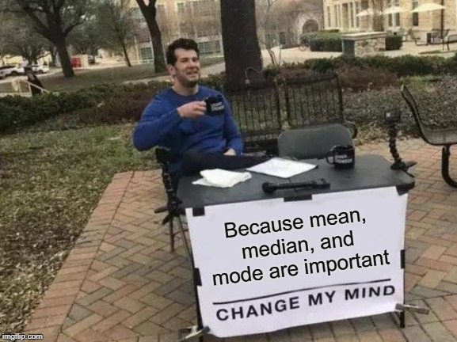

Slide 41


Slide 42


Slide 43
The point is…
Although we know about these measures of central tendency, we may not be using them to their full potential
Many of the descriptive statistics that we aware of (e.g., mean) are meaningless if they are not reported in tandem with other important information
What other important information should accompany the mean…

Slide 44
Variance
Standard deviation
SD is an estimate of the average variability (spread) of a set of observations around the mean
Importantly, SD is expressed in the same units of measurement as the raw scores
It is the square root of the variance (sqrt[sum of squares/number of values])

Slide 45

Variance
Range
The range of scores is the value of the smallest score subtracted from the highest score
Range = $Highest score −lowest score$
= 8 – 3
= 5

Slide 46
Shape
Skewness
Kurtosis

Slide 47
Shape
Skewness → a measure of the symmetry of a frequency distribution
Kurtosis

Slide 48
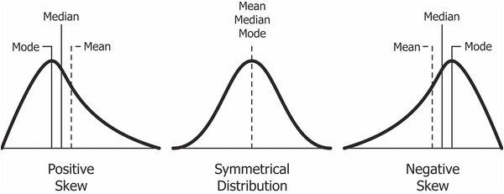
Shape
Skewness → a measure of the symmetry of a frequency distribution
Kurtosis
Symmetrical distributions have a skew of 0
When the frequent scores are clustered at the lower end of the distribution and the tail points to the higher (more positive) scores, the value of skew is positive
When the frequent scores are clustered at the higher end of the distribution and the tail points to the lower (more negative) scores, the value of skew is negative

Slide 49
Shape
Skewness → a measure of the symmetry of a frequency distribution
Kurtosis
Symmetrical distributions have a skew of 0
When the frequent scores are clustered at the lower end of the distribution and the tail points to the higher (more positive) scores, the value of skew is positive
When the frequent scores are clustered at the higher end of the distribution and the tail points to the lower (more negative) scores, the value of skew is negative

Slide 50
Shape
Skewness → a measure of the symmetry of a frequency distribution
Kurtosis
Symmetrical distributions have a skew of 0
When the frequent scores are clustered at the lower end of the distribution and the tail points to the higher (more positive) scores, the value of skew is positive
When the frequent scores are clustered at the higher end of the distribution and the tail points to the lower (more negative) scores, the value of skew is negative

Slide 51
Shape
Skewness → a measure of the symmetry of a frequency distribution
Kurtosis
Symmetrical distributions have a skew of 0
When the frequent scores are clustered at the lower end of the distribution and the tail points to the higher (more positive) scores, the value of skew is positive
When the frequent scores are clustered at the higher end of the distribution and the tail points to the lower (more negative) scores, the value of skew is negative

Slide 52
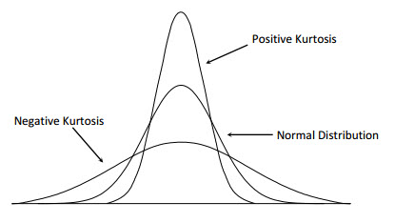
Shape
Skewness
Kurtosis → a measure of the degree
to which scores cluster in
the tails of a frequency
distribution
Normal kurtosis = 3
Kurtosis < 3 → Platykurtic
(the distribution produces fewer and less extreme values [e.g., outliers] than does the normal distribution)
Kurtosis > 3 → Leptokurtic
(this distribution produces more extreme values [e.g., outliers] than the normal distribution)

Slide 53
Shape
Skewness
Kurtosis → a measure of the degree
to which scores cluster in
the tails of a frequency
distribution
Normal kurtosis = 3
Kurtosis < 3 → Platykurtic
(the distribution produces fewer and less extreme values [e.g., outliers] than does the normal distribution)
Kurtosis > 3 → Leptokurtic
(this distribution produces more extreme values [e.g., outliers] than the normal distribution)

Slide 54
Shape
Skewness
Kurtosis → a measure of the degree
to which scores cluster in
the tails of a frequency
distribution
Normal kurtosis = 3
Kurtosis < 3 → Platykurtic
(the distribution produces fewer and less extreme values [e.g., outliers] than does the normal distribution)
Kurtosis > 3 → Leptokurtic
(this distribution produces more extreme values [e.g., outliers] than the normal distribution)

Slide 55
Threats to descriptive statistics
Missing data
Outliers
Range restriction

Slide 56
Threats to descriptive statistics
Missing data
Outliers
Range restriction
1. Missing Completely at Random (MCAR)
2. Missing at Random (MAR)
3. Missing Not at Random (MNAR; this type of missingness cannot be ignored)
See https://www.theanalysisfactor.com/missing-data-mechanism/ for an explanation of each type of missing data.

Slide 57
Interpreting descriptive statistics
As previously mentioned, descriptive statistics should be reported in tandem with other descriptive statistics
The mean is not informative without reporting the corresponding SD
The raw frequency is not informative without reporting the corresponding relative frequency
Etc.
Descriptive statistics are the gateway to more sophisticated, in-depth analyses
Imagine that you observe low levels of job satisfaction among female employees. The next question that might need to be addressed is, “Why are females experiencing low levels of job satisfaction?”

Slide 58
Interpreting descriptive statistics
As previously mentioned, descriptive statistics should be reported in tandem with other descriptive statistics
The mean is not informative without reporting the corresponding SD
The raw frequency is not informative without reporting the corresponding relative frequency
Etc.
Descriptive statistics are the gateway to more sophisticated, in-depth analyses
Imagine that you observe low levels of job satisfaction among female employees. The next question that might need to be addressed is, “Why are females experiencing low levels of job satisfaction?”

Slide 59
Interpreting descriptive statistics
As previously mentioned, descriptive statistics should be reported in tandem with other descriptive statistics
The mean is not informative without reporting the corresponding SD
The raw frequency is not informative without reporting the corresponding relative frequency
Etc.
Descriptive statistics are the gateway to more sophisticated, in-depth analyses
Imagine that you observe low levels of job satisfaction among female employees. The next question that might need to be addressed is, “Why are females experiencing low levels of job satisfaction?”

Slide 60
Comparing means
t-test
A t-test is a type of inferential statistic used to determine if there is a significant difference between the means of two groups, which may be related in certain features.
Essentially, a t-test allows us to compare the average values of the two data sets and determine if they came from the same population.
Remember Module 1 and NHST? What does the null hypothesis propose for a t-test?

Slide 61
Comparing means
t-test
A t-test is a type of inferential statistic used to determine if there is a significant difference between the means of two groups, which may be related in certain features.
Essentially, a t-test allows us to compare the average values of the two data sets and determine if they came from the same population.
Remember Module 1 and NHST? What does the null hypothesis propose for a t-test?

Slide 62
Comparing means
t-test
Remember Module 1 and NHST? What does the null hypothesis propose for a t-test?
Null hypothesis:
A statistical test of the hypothesis that suggests that there is no difference between specified populations (or no relation between constructs) and that any observed difference is due to sampling or experimenter error.
r = 0
Null hypothesis (for a t-test):
There is no mean difference between the two groups under investigation
Therefore, a statistically significant t-test result (i.e., p < .05) suggests that we should “reject the null hypothesis” because the evidence indicates that a mean group difference does exist.
Null hypothesis:
There is no relation between emotional exhaustion and turnover behavior
Emotional exhaustion → Turnover
r = 0

Slide 63
Comparing means
t-test
Remember Module 1 and NHST? What does the null hypothesis propose for a t-test?
Null hypothesis:
A statistical test of the hypothesis that suggests that there is no difference between specified populations (or no relation between constructs) and that any observed difference is due to sampling or experimenter error.
r = 0
Null hypothesis:
There is no relation between emotional exhaustion and turnover behavior
Emotional exhaustion → Turnover
r = 0

Slide 64
Comparing means
t-test
Remember Module 1 and NHST? What does the null hypothesis propose for a t-test?
Null hypothesis:
A statistical test of the hypothesis that suggests that there is no difference between specified populations (or no relation between constructs) and that any observed difference is due to sampling or experimenter error.
r = 0
Null hypothesis (for a t-test):
There is no mean difference between the two groups under investigation
Null hypothesis:
There is no relation between emotional exhaustion and turnover behavior
Emotional exhaustion → Turnover
r = 0

Slide 65
Comparing means
t-test
Remember Module 1 and NHST? What does the null hypothesis propose for a t-test?
Null hypothesis:
A statistical test of the hypothesis that suggests that there is no difference between specified populations (or no relation between constructs) and that any observed difference is due to sampling or experimenter error.
r = 0
Null hypothesis (for a t-test):
There is no mean difference between the two groups under investigation
Therefore, a statistically significant t-test result (i.e., p < .05) suggests that we should “reject the null hypothesis” because the evidence indicates that a mean group difference does exist.
Null hypothesis:
There is no relation between emotional exhaustion and turnover behavior
Emotional exhaustion → Turnover
r = 0

Slide 66
Comparing means
ANOVA
A t-test is a type of inferential statistic used to determine if there is a significant difference between the means of two or more groups, which may be related in certain features.

